Slide 1
Generalizing LLMs for Accelerators with RL
Antonin Sulc
RL4AA'25

Slide 2

Summary
Do you want to hear a story of a
I am exaggerating, but we want to show you what didn’t work

Slide 3
Ok, now real summary
We show what we wanted to achieve
What motivated us to do that
With what kind of data
How we preprocessed the data
How we performed O.K in Supervised Training (SFT)
How we performed less O.K on GRPO
Lesson learned

Slide 4
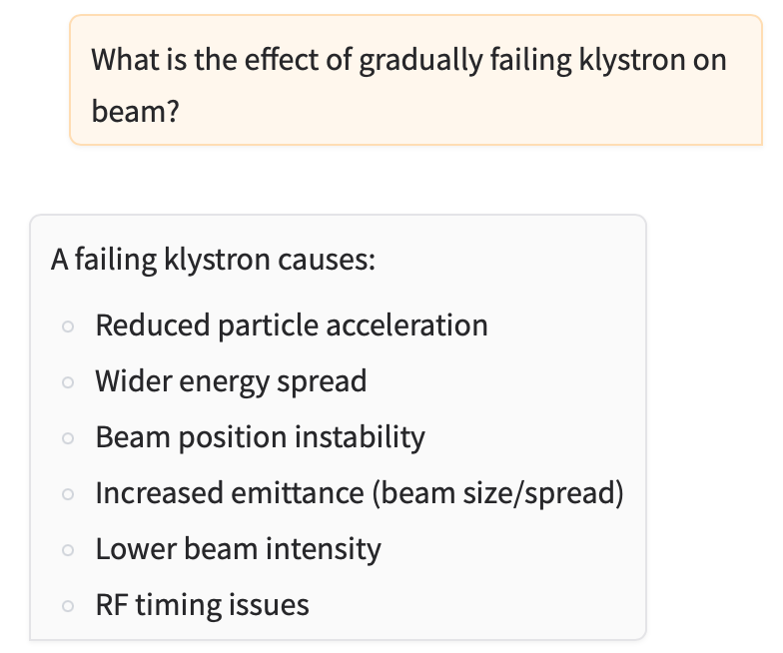
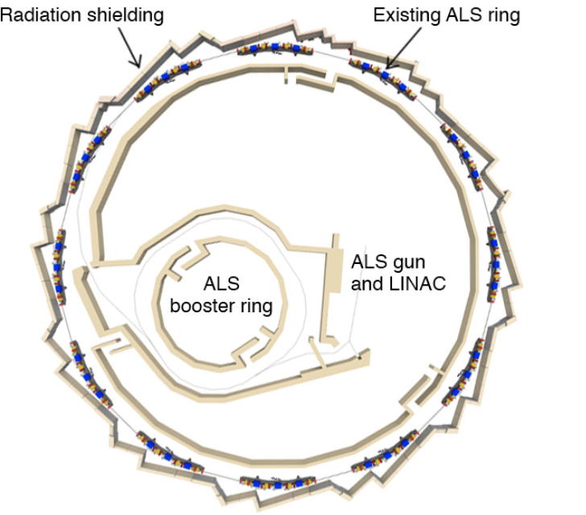
Motivation
Current models are impressive, including physics
Why not learn it the infrastructure, e.g.:
After drift tube L2 there is focusing quadrupole Q1
This would allow us to analyze questions tailored specifically to ALS, e.g.:
Q: Why there is increased radiation around Q10?
A:This can be because to my knowledge there is no shielding yet. However according to [1] there is plan to install shielding at Q12
‹#›

Slide 5
Motivation
Why would you train your LLM if you can do the same with passing the information about lattice in prompt?
Memorization vs Open Book Questioning
🎓 📘
If you train a LLM, you “memorize” and constrain your knowledge,
If you pass the information in every query, you are “looking in the textbook while doing the exam”
We know that SFT learns, but RL generalizes [1]
There are several examples where LLMs showed emergent behaviors (e.g.[2])
This might help us to better understand our machine.
[1] SFT Memorizes, RL Generalizes: A Comparative Study of Foundation Model Post-training
[2] Li et al. Emergent World Representations: Exploring a Sequence Model Trained on a Synthetic Task

Slide 6
Motivation
Supervised Fine-Tuning (SFT)
Trains to mimic human-generated examples by minimizing prediction error on labeled data
Tends to memorize training patterns rather than learn generalizable rules
Reinforcement Learning
Trial and error using reward signals from a verifier
learning generalizable knowledge
general knowledge
memorize
generalize
Where is Hamburg?
France Norway U.S.A Germany
Pretrained
SFT
RL
Where is Hamburg?
Hamburg is Northern Germany

Slide 7
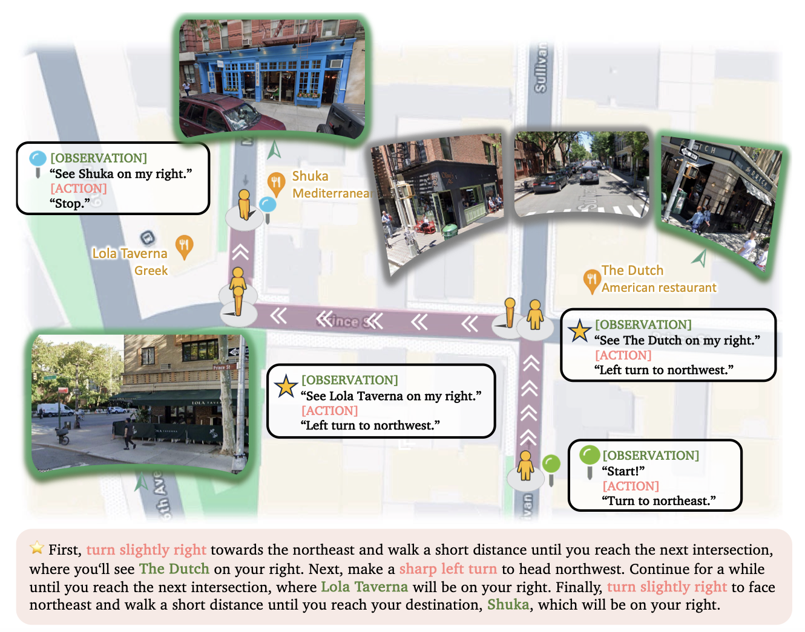
Motivation

Slide 8
Data
For testing purposes, we started low with the injector,
the section between gun and booster ring
We have different elements: drifts, corrector magnets (horizontal/vertical), quadrupoles (F/D), bending magnets, BPMs and TVs
For some, we have numerical strength (k for quadrupoles..
Can we fine tune LLM to interpret behaviour of injector

Slide 9
Technical Details
Model qwen2.5:3b
Single A100, 40GB was enough
Full fine-tuning (no LoRA)
We tried LoRA, but it failed on the SFT already, either by nor memorizing anything or by overfitting
RL was trained with GRPO (Group Relative Policy)

Slide 10
Input Data - Supervised Fine Tuning (SFT)
Generate training data for supervised fine-tuning as follows
Element Information: Descriptions of individual elements with their properties
"Describe the element Q32 in the lattice"
Sequence Completion: Filling in missing elements in subsequences
"What element should replace ? in the lattice: Q31, ?, Q33"
Element Prediction: Predicting next/previous elements in sequence
"Given the lattice sequence Q31, Q32, what is the next element?"
Parameter Queries: Questions about specific element properties
"What is the strength of Q32?"
Subsequence Queries: Information about elements between two points
Example: "What are the elements between Q31 and Q36 (inclusive)?"
Approximately 6000 data points

Slide 11
Input Data - SFT - More advanced
Perturbation Handling: Variations with slightly modified parameters
Helps model generalize to parameter variations
Type-Specific Queries: Questions about element types, strengths, lengths
Multiple formulations of the same question to improve robustness
Negative Examples:
"What element is not directly after X?"
Prevents model from making simplistic numerical predictions
We tried to vary the input/output language, but still …
5 different ways how to ask about element type
“What type of element is {elem['Name']}?",
"What is the element type of {elem['Name']}?",
"Identify the type category of {elem['Name']}.",
"Which element type applies to {elem['Name']}?",
"How would you categorize {elem['Name']}?",

Slide 12
Results of Supervised Fine Tuning (SFT)
Q: What is the name of the particles that make up an atomic nucleus along with protons?
A: neutrons ✅
Just sanity check if model does not overfit. This is already in the LLM
Q: What is the unit of energy commonly used in particle accelerators?
assistant
A: The unit of energy commonly used in particle accelerators is the electronvolt (eV). ✅
Q: What is length of L2?
A: Length of L2 is 0.644m ✅
Q: Length of L2?
A: Length of L2 is 0.6m
❌ Incomplete (0.644)
Q: What would the length be if there is an element L2?
A: Length of L2 is 0.34m
❌ Sensitive
Q: What is element after L2?
A:L3
❌ Hallucination

Slide 13
Results of SFT - Larger learning rate
Q: What is the name of the particles that make up an atomic nucleus along with protons?
A: It is a BPM1
❌ Catastrophic forgetting
Q: What is the unit of energy commonly used in particle accelerators?
assistant
A: It is a BPM1
❌ Catastrophic forgetting
Q: What is length of L2?
A: Length of L2 is 0.644m ✅
Q: Length of L2?
A: BPM1 is 1m
❌ high variance (0.644)

Slide 14
Input Data - Reinforcement Learning
Dataset that challenges model to understand spatial relationships in the lattice that had already learned
Distance from first element”:
"What is distance of L2 from first element?"
Noise Variation: Additional datasets with small Gaussian noise (σ=0.1)
10% of samples include realistic measurement variations
Tests robustness to minor perturbations in physical systems

Slide 15
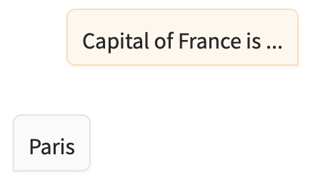
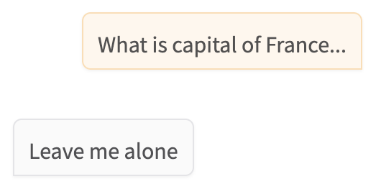
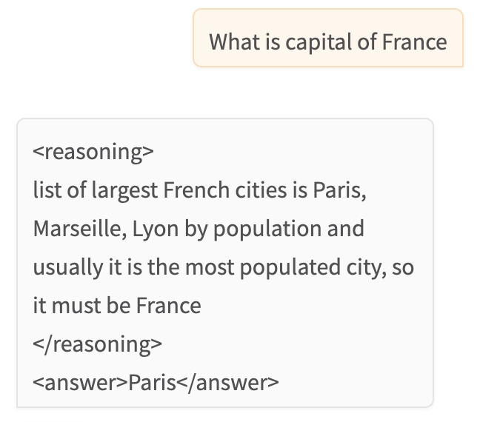
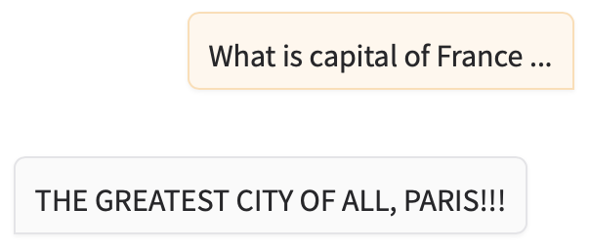
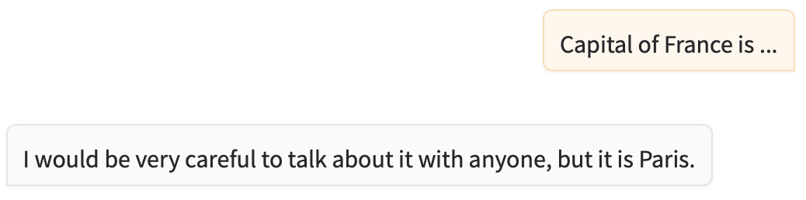
Intermezzo - Reasoning
You are a teenager chatbot
You are useful chatbot.
You are a chatbot that reasons about user questions
<reasoning>
reasoning about the question
</reasoning>
<answer>
place for answer
</answer>
You are EXTREMELY EXCITED about EVERYTHING!!!
You are chatbot who explain everything with conspiracies

Slide 16
Results of RL (GRPO)
Q: What is length of L2?
A: <reasoning>
There is an element L2 whose length is 0.644m
</reasoning>
<answer>0.644m</answer> ✅
Q:What is distance between HCM1 and L10?
<reasoning>
To find the distance between HCM1 and L10, I need to sum the lengths of the components between them. Starting from HCM1 and moving towards L14:
(1). Length from HCM1 to L6: 0.1524m (2.) Length from L6 to L8: 0.0m (3.) Length from L8 to L10: 0.0m </reasoning>
<answer>
2.0353m ✅
</answer>
❌ (HCM, L4, VCM1, …

Slide 17

Conclusions
After all, I hope it was
You heard about:
SFT for memorizing information about our knowledge
RL that was supposed to reason and generalize
While SFT “worked”, RL had tendency to overfit
What we want to improve:
Have less narrow dataset
Use other LLM to generate unique question and answer that share the right “name”
Use logbook data to understand our facility

